Slide 1

Capstone Project - 1 Play Store App Review Analysis Presented By
Aniket Abhit Jadhav
Subhash Ram Achal Mishra
Data Science Trainee, AlmaBetter

Slide 2

Index:
Introduction.
Abstract.
Problem statement.
Exploring the database.
Analysis of share of apps according to there category.
Top installed Apps category.
Rating Analysis.
Sentiment Analysis based on category.
Reviews analysis.
Different types of apps base on prices(Free/Paid).
Conclusion.
Referance.

Slide 3
Introduction:
Data provided by Play store, which is operated and developed by Google. Play store has a million number of similar or different kinds of apps which are tagged by different Genres. These apps are available for both free and paid. . It has many categories to choose the type of application that the user wants to install on his device. Doing a data analysis on the data of the google play store along with the user review dataset will help us to get to know the most dominant category among all the available ones. It also allows us to track the number of installs per category and the most popular application among people of different age groups, the polarity of the sentiment of the reviews given to each application.
Play store is an Android Market serves as the official app store for certified devices running on the Android Operating system. Developed and Operated by Google, launched on 6th March, 2012. Approximately 3.48 million apps are in the Play store. Play store apps have their own features such as Ratings, Reviews, Size and more.

Slide 4
Abstract:
The Project “Play Store App and Review Analysis” is based on discovering key understandings about the different categories of apps available on the Google Play Store, the installation per category, the count of reviews per app, and the sentimental of the reviews per app.
In this analysis, we’re provided with a dataset with some records. We did a basic inspection, and data cleaning to remove suspicious data and to avoid an error. We’ve used different plots to visualize our analysis in the easiest way. This can be used to know which type or category of app is installed the most, count of the applications available per category, distribution of the rating how much of these apps are paid or are available for free, to know the sentiment of the reviews, the polarity of the sentiment.
Our features based analysis on the database can help to find the key factors which are responsible for the app engagement, popularity and success.

Slide 5

Problem Statement:
The Play Store apps data has enormous potential to drive app-making businesses to success .Android is expanding as an operating system and Mobile app industry is increasing in significantly and thus giving rise to more competitions to the one’s that are creating applications .Due to the competition in the market and also expansion in order to help our developer understand what kinds of apps are likely to attract more users and what is the motivating factor for the people to download an app we analyze and research relevant data. For the app development in dustry where they can analyse the downloads and demand off app download in the industry.
The Problem statements are :
What are the top categories on Play Store?
Are majority of the apps Paid or Free?
How importance is the rating of the application?
Which categories from the audience should the app be based on?
Which category has the most no. of installations?
How does the last update has an effect on the rating?
How does the count of apps varies by Genres?
How are ratings affected when the app is a paid one?

Slide 6
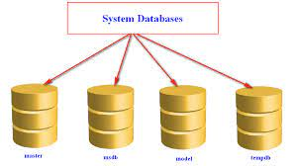
Exploring Database:
Loading the data sets: Two datasets , First Playstore app
dataset and User review database.
Importing Libraries: NumPy, Pandas, Seaborn and Matplotlib.
Data Cleaning : Null values, Finding and removing Outliers,
Removing duplicates data.
Data Imputation: Filling the missing category values with
mode and numerical values with
median. Conversion of price, installs,
reviews into numerical values.
Exlporatory Data Analysis: Analyzing the data sets to
summarize their main
charateristics using statistical
graphics and data visualization
method.

Slide 7
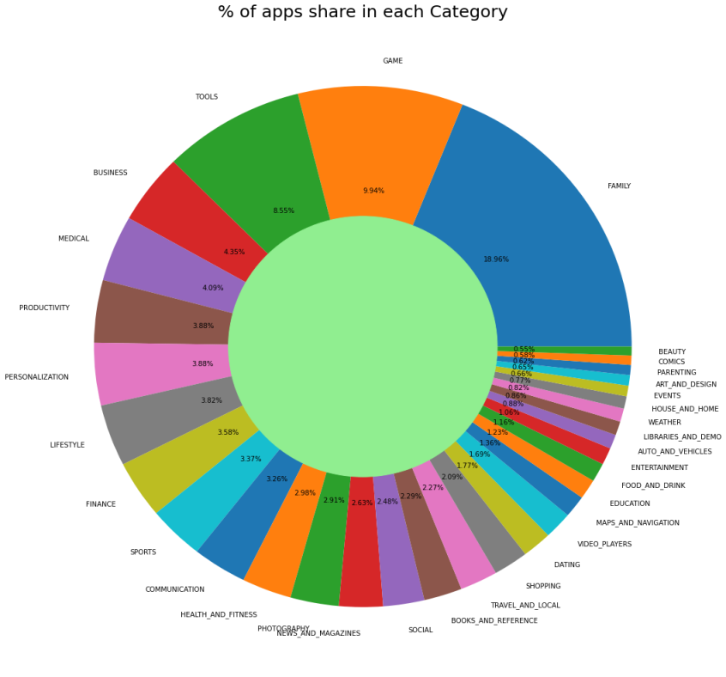
Analysis of share of apps according to there category.
From the plot we can see that Playstore has almost 33 categories.
Here we see the highest percentage of share comes in the FAMILY category with 18.96% , where GAME contents 9.94% . of share, here we see the on third position TOOLS is having 8.55%
Similarly on the opposite side the lowest percentage of the share is from category BEAUTY with 0.55%, where second lowest is an COMICS category with 0.58%, and the third lowest is of PARENTING along with 0.62%.

Slide 8
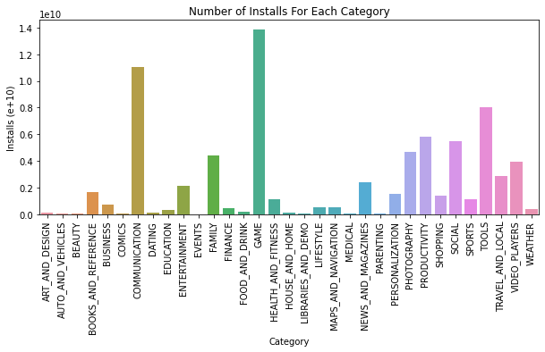
Most installed apps category wise:
The weightage of games and communication is much higher that all other category.

Slide 9
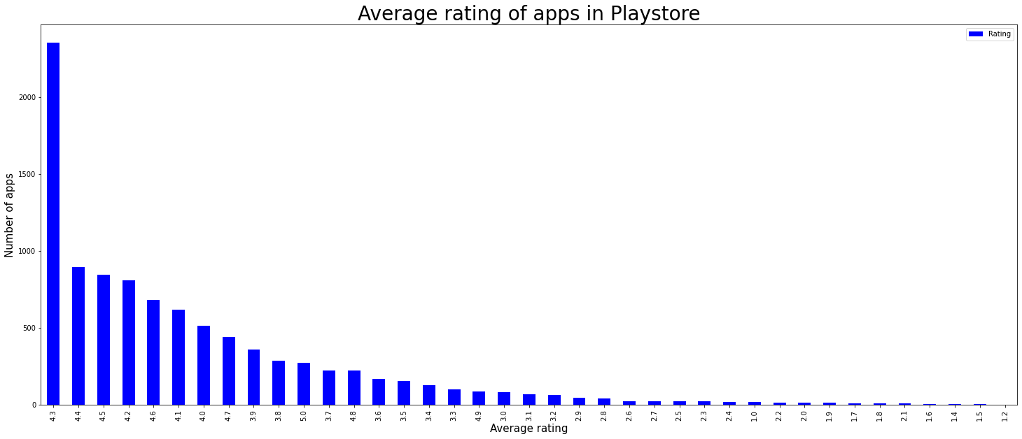
Average Rating Analysis:
As chart shows most of the apps having rating between 3.5 to 4.8.
4 – 5 : Top Rated
3 – 4 : Above Average
2 – 3 : Average
1 – 2 : Below Average

Slide 10
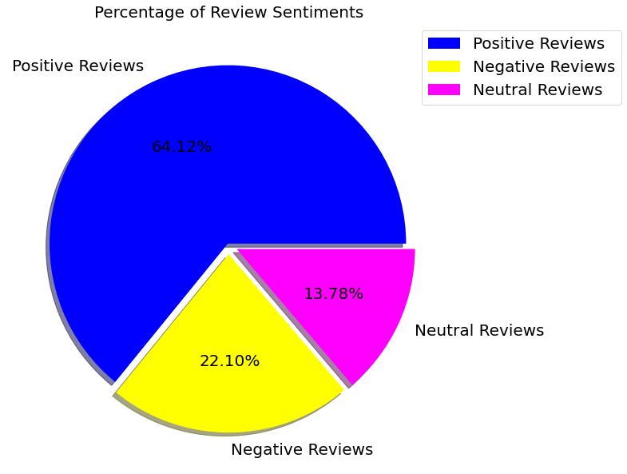
Percentage of Sentiment Review analysis:
Percentage of Review Sentiments-:
Positive Reviews = 64.12%
Negative Reviews = 22.10%
Neutral Reviews = 13.78%

Slide 11
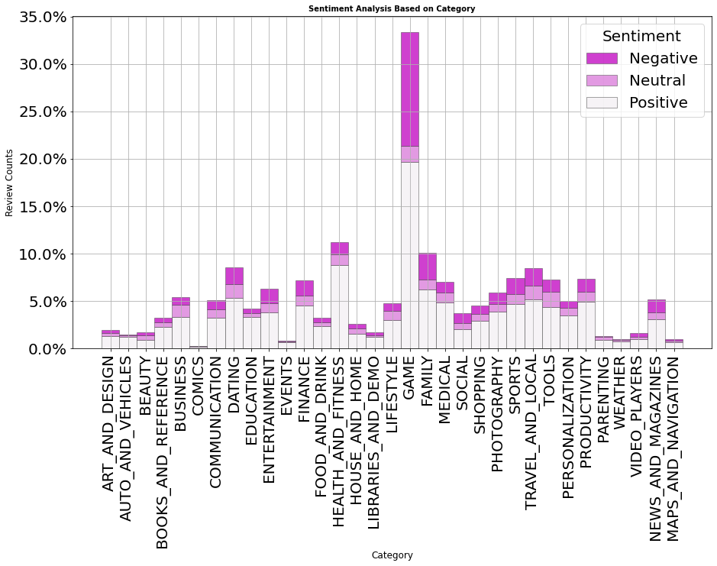
Sentiment Analysis Based on Category
Here we conduct the graph which show type sentiment analysis from each category.
This graph help us to know which category get highest sentiment review as well as compare of +ve and -ve review.
Family, Sports and Health & Fitness apps perform the best, Having more than 50% positive reviews and Game and Social apps perform decent leading to 50% positive and 50% negative.
The number of review of game is much more higher in compare to other.

Slide 12
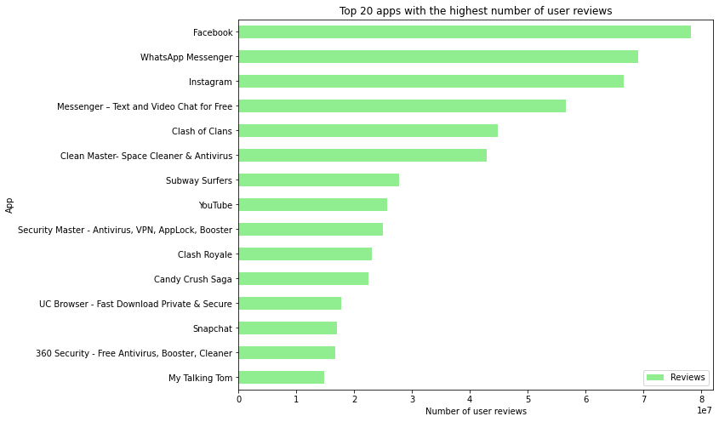
Apps having the highest number of reviews
As we see in chart the highest review apps
are Facebook , WhatsApp Messenger and Instagram.
As we see the most reviewed app is from Social media platform.
After social media apps there is apps comes from GAMING category.
Clash of Clans has the most reviews in the gaming category.
And Subway Surfers has the 2nd most review app from the GAMING category.

Slide 13
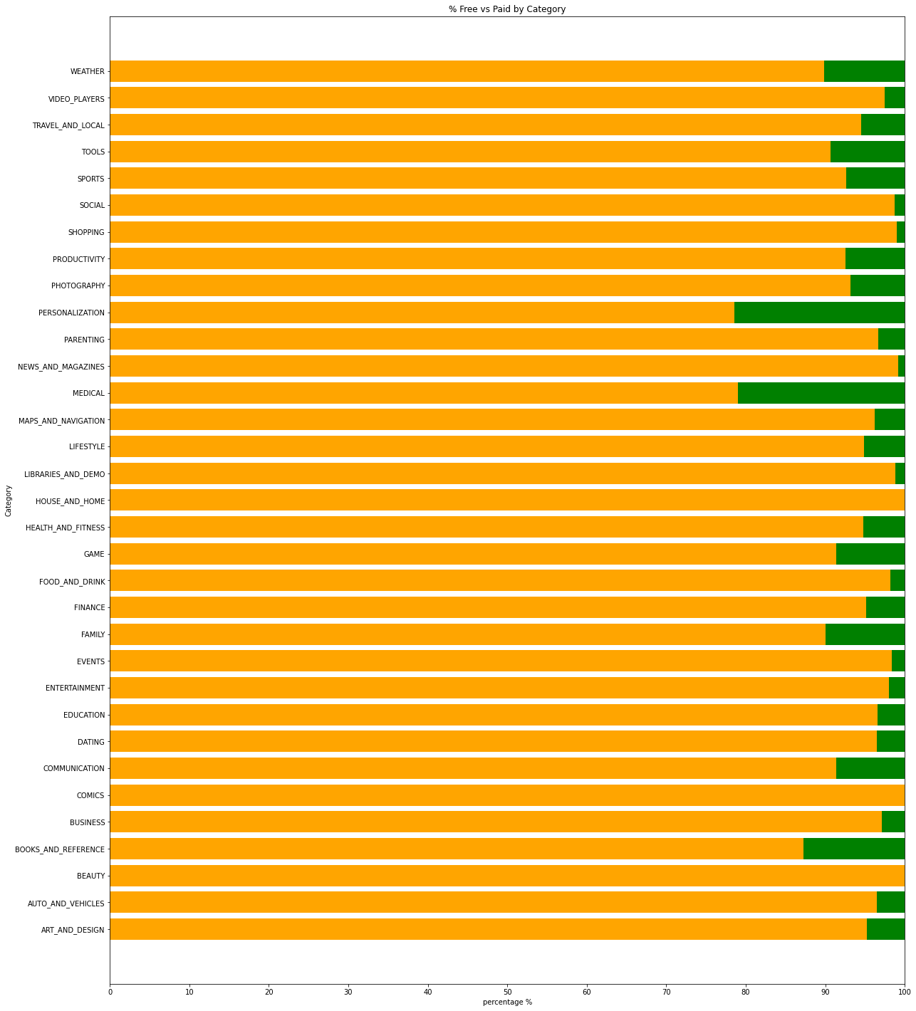
Free vs Paid Apps category wise:
As per the study of chart we can say that every category has more than 75% of apps that are free for user.
Apps from COMMUNICATION and BEAUTY category has most free apps.
Category like MEDICAL and PERSONALIZATON has the lowest free apps.

Slide 14
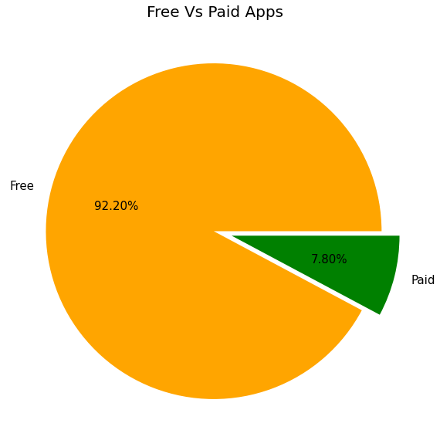
Percentage of Paid Vs Free Apps:
According to the study of graph we can
see that:
Free Apps – 92%.
Paid Apps – 8% .

Slide 15
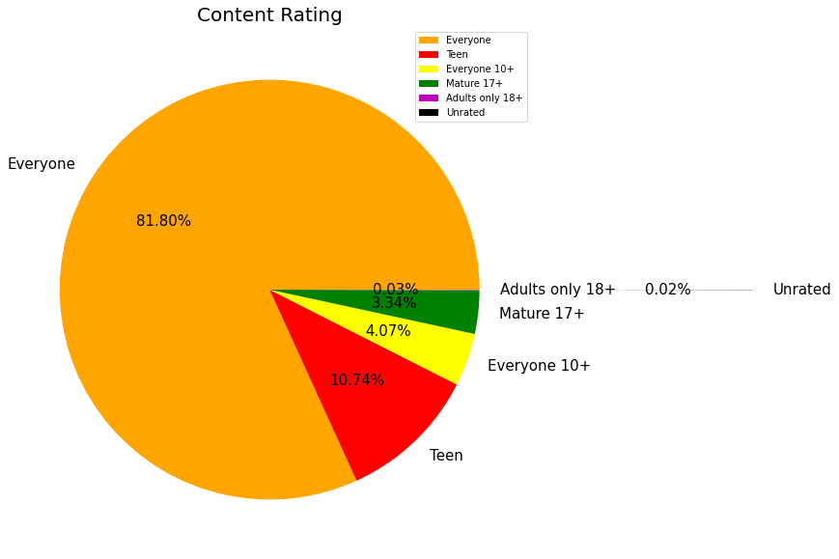
Content Rating:
Rating According to:
Everyone – 81.80%
Teens – 10.74%
Everyone 10+ – 4.07%
Mature 17+ – 3.34%
Adult only 18+ – 0.03%

Slide 16
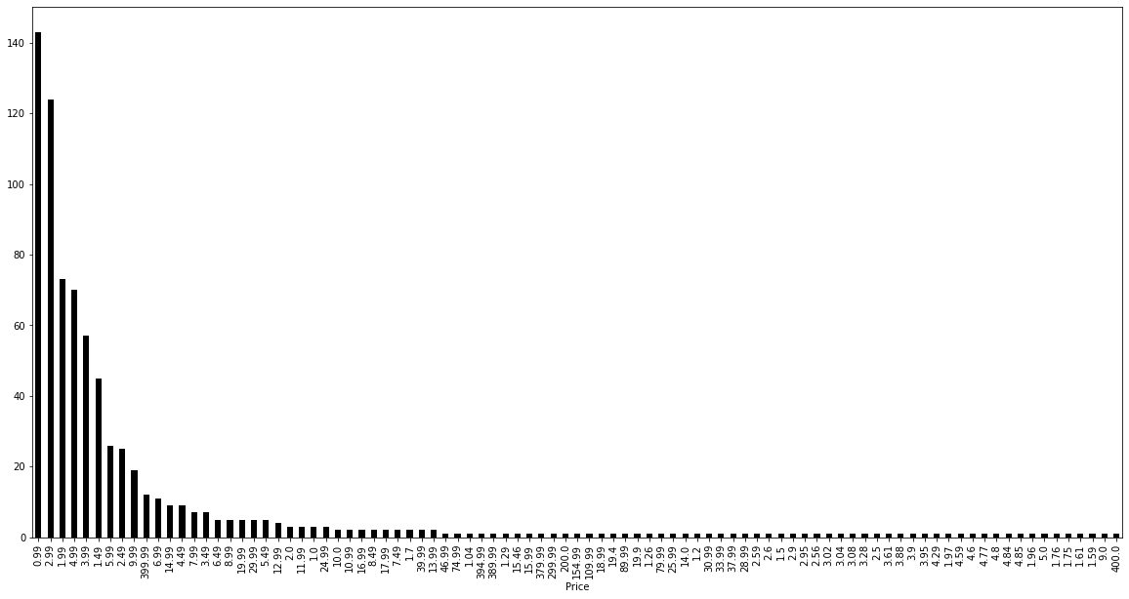
Number of apps installed at particular price.
There are so many apps charge a small amount as well as larger amount which varies from USD 0.99 to
USD 400
In order to select the top paid apps, it won’t fair to look just into the number of installs . This is because the apps that charge a lower installation fee will be installed by more number of people in general
The paid apps charge the users a certain amount to download and install the app.

Slide 17
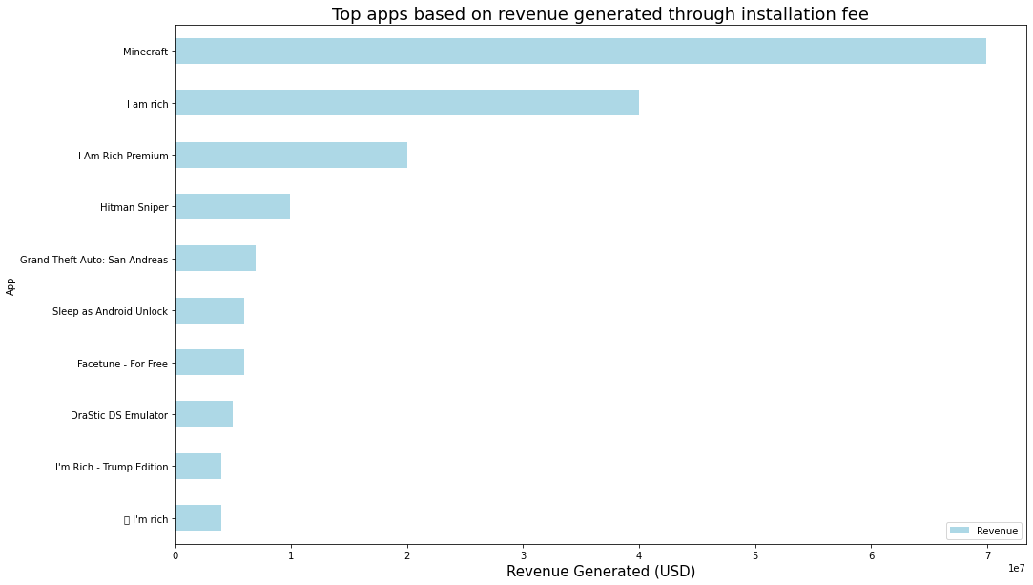
top apps based on revenue generated through installation fee
According to the study of Graph, the highest revenue generated app is Minecraft.
Second position of highest revenue generated app is hold by I am rich.
And the I am Rich Premium is at the 3 position.

Slide 18
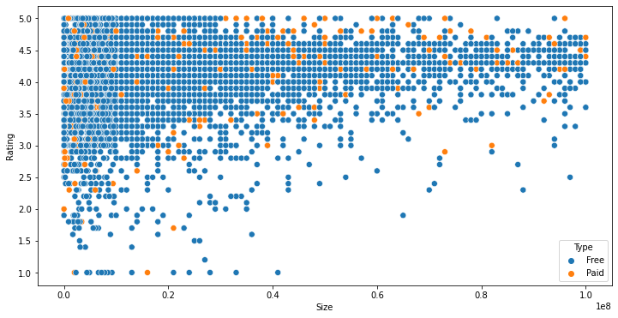
Distribution of apps in term of their rating, size and type.
From the above scatter plot, we can say that the most of the apps are free and having small in size and also having
a high rating.
While for paid apps, we have quite equal distribution in terms of size and rating.

Slide 19
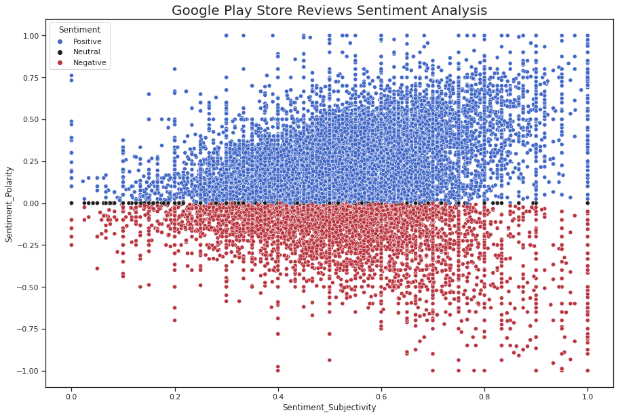
Review Sentiment analysis
As per study of Review sentiment analysis the are 3 types of reviews:-
Positive.
Negative.
Neutral.
From this plot it can be concluded that sentiment subjectivity is not always proportional to sentiment polarity but in maximum number of case, Show a proportional behavior, when variance is too high or low

Slide 20
Conclusion
In this project of analyzing play store applications, we have worked on several parameters and got some actionable insights that would help any organization to do well in the Android market.
As per as EDA shown above:
The weightage of the installation of the app, which belongs to the games and communication categories, is much higher than all other categories . we can see that messenger, Skype, and WhatsApp have the most users in the communication category.
Most of the market is cover by 'FAMILY' category follows by 'GAME' and 'TOOLS'.
After we compare rating and category. we saw every category has a slightly similar rating. There is so much similarity in both.
We find that most of the apps are free of charge for users, There are 92% of the apps are free and 8% of apps are paid.
As we come to the average rating of the app, and we saw that most of the people have given top ratings of between 3.5 and 4.8.

Slide 21
After studing the data we also come to know that MINICRAFT app creates the highest amount of revenue in the play store.
We find there are a lot of apps that charge a small amount, whereas some apps charge a larger amount. In this case, the price to download an app varies from USD 0.99 to USD 400.
We can also conclude that FACEBOOK, WHATSAPP MESSENGER, and INSTAGRAM are the top three apps that have the highest reviews.
We also see that the applications belongs to ‘Everyone’ does not have age restriction.
After understanding the data we come to know that majority of the free apps are small in size and having high rating. While for paid apps, we have quite equal distribution in term on size and rating.
We saw the sentiments of the user review data, and we found most of the reviews are of positive sentiment, while negative and neutral sentiments have a low number of reviews.
Here we notice that most of the reaction are from 'Game' category and very less from 'Comics', 'Events', 'Maps_And_Navigation' and 'Weather'. This shows that people take much interest in Game catagory app as compare to other apps.
.From the above scatter plot it can be concluded that sentiment subjectivity is not always proportional to sentiment polarity but in maximum number of case, shows a proportional behavior, when variance is too high or low

Slide 22
References
Geeks for Geeks
Analytics Vidhya
Stack overflow
Towards data science
Python libraries documentation
Data camp
Medium

Slide 23


